Slide 1
Lecture 2

Slide 2
Minimum Norm Solutions

Slide 3
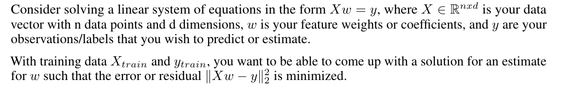
Solving Linear Systems

Slide 4
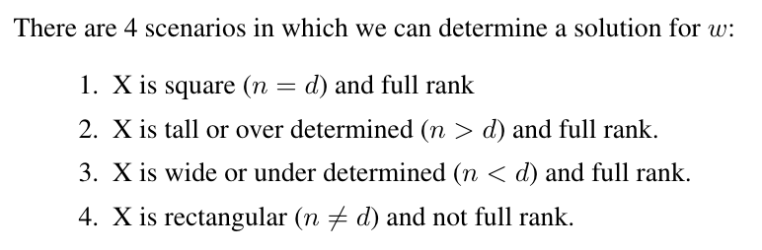
4 Scenerios for Linear Equations

Slide 5
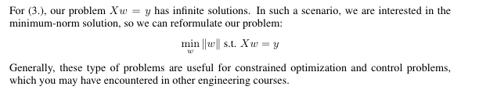
Underdetermined Equations and Minimum norm

Slide 6
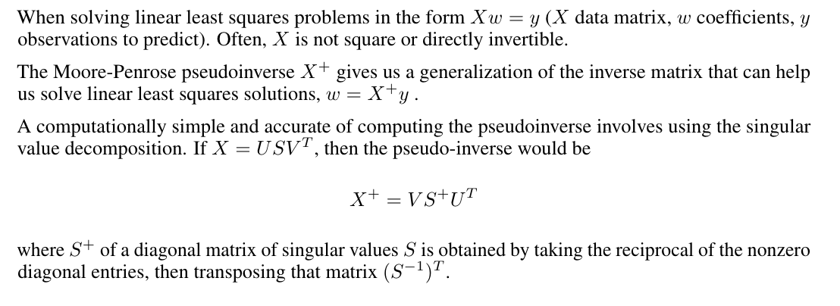
Moore Penrose pseudo-inverse

Slide 7
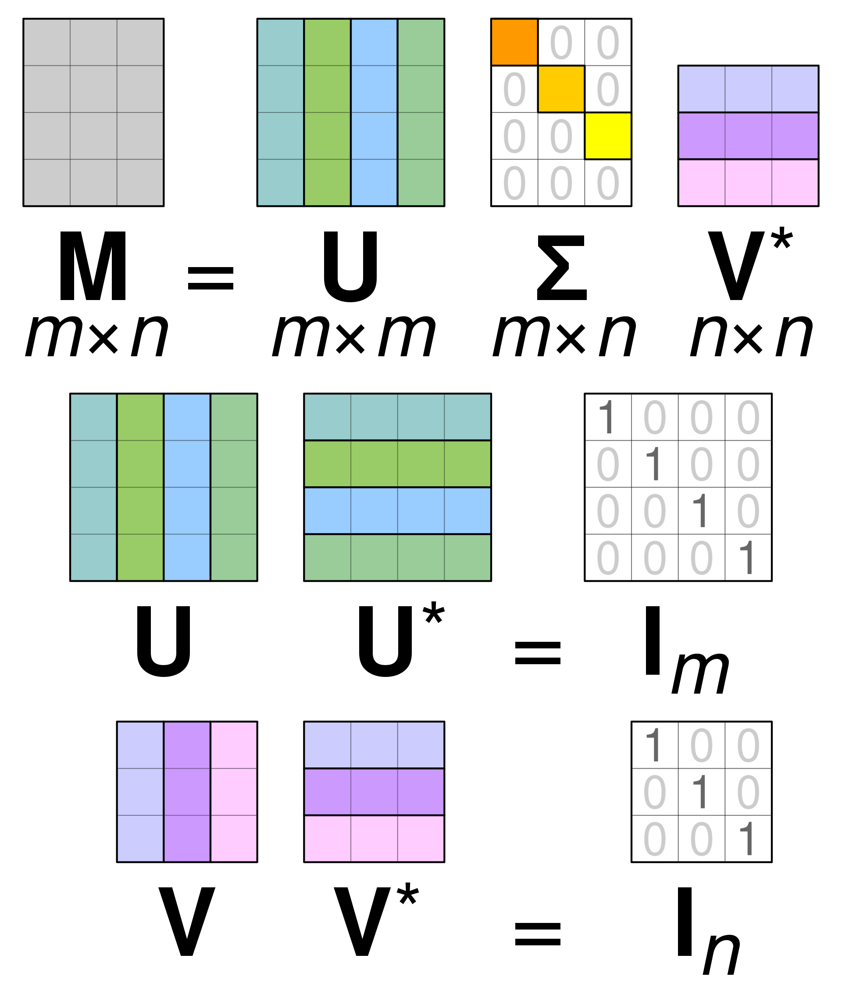
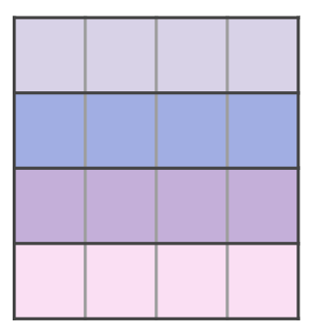
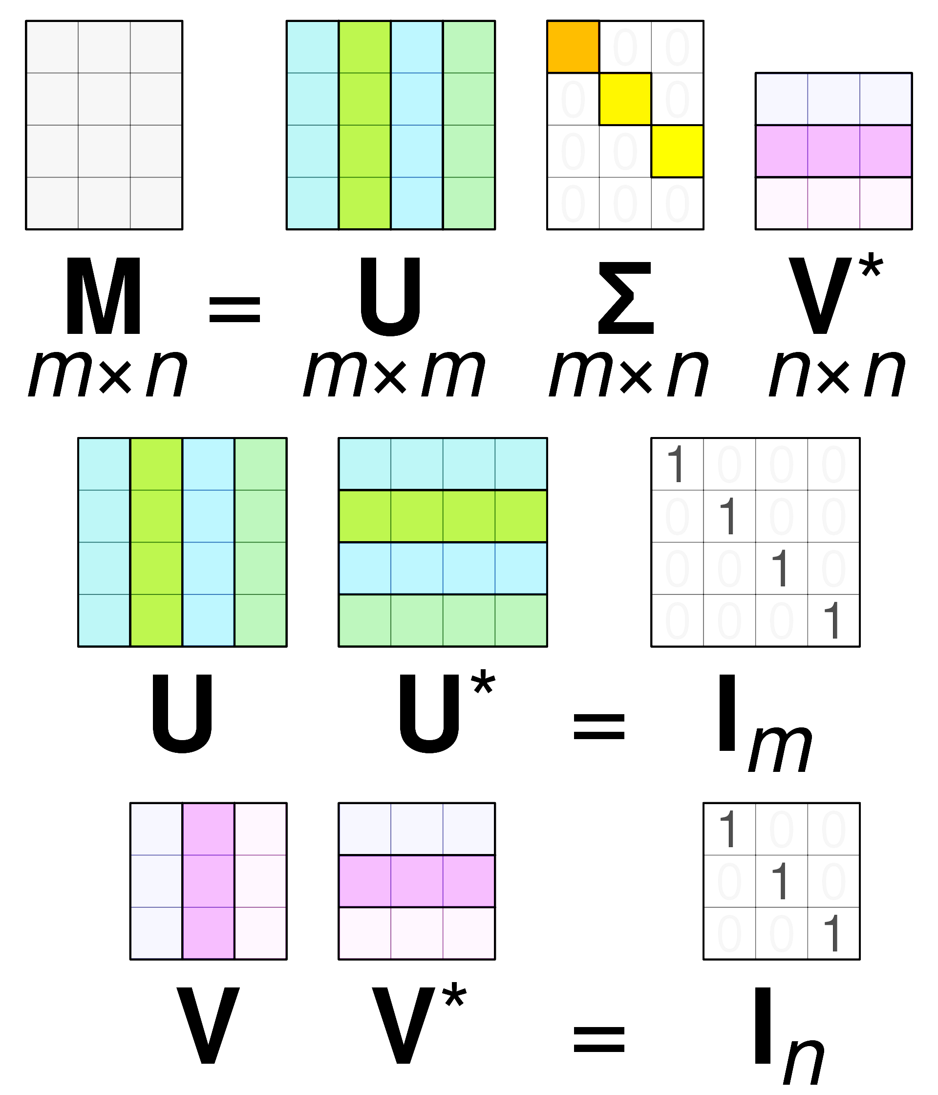
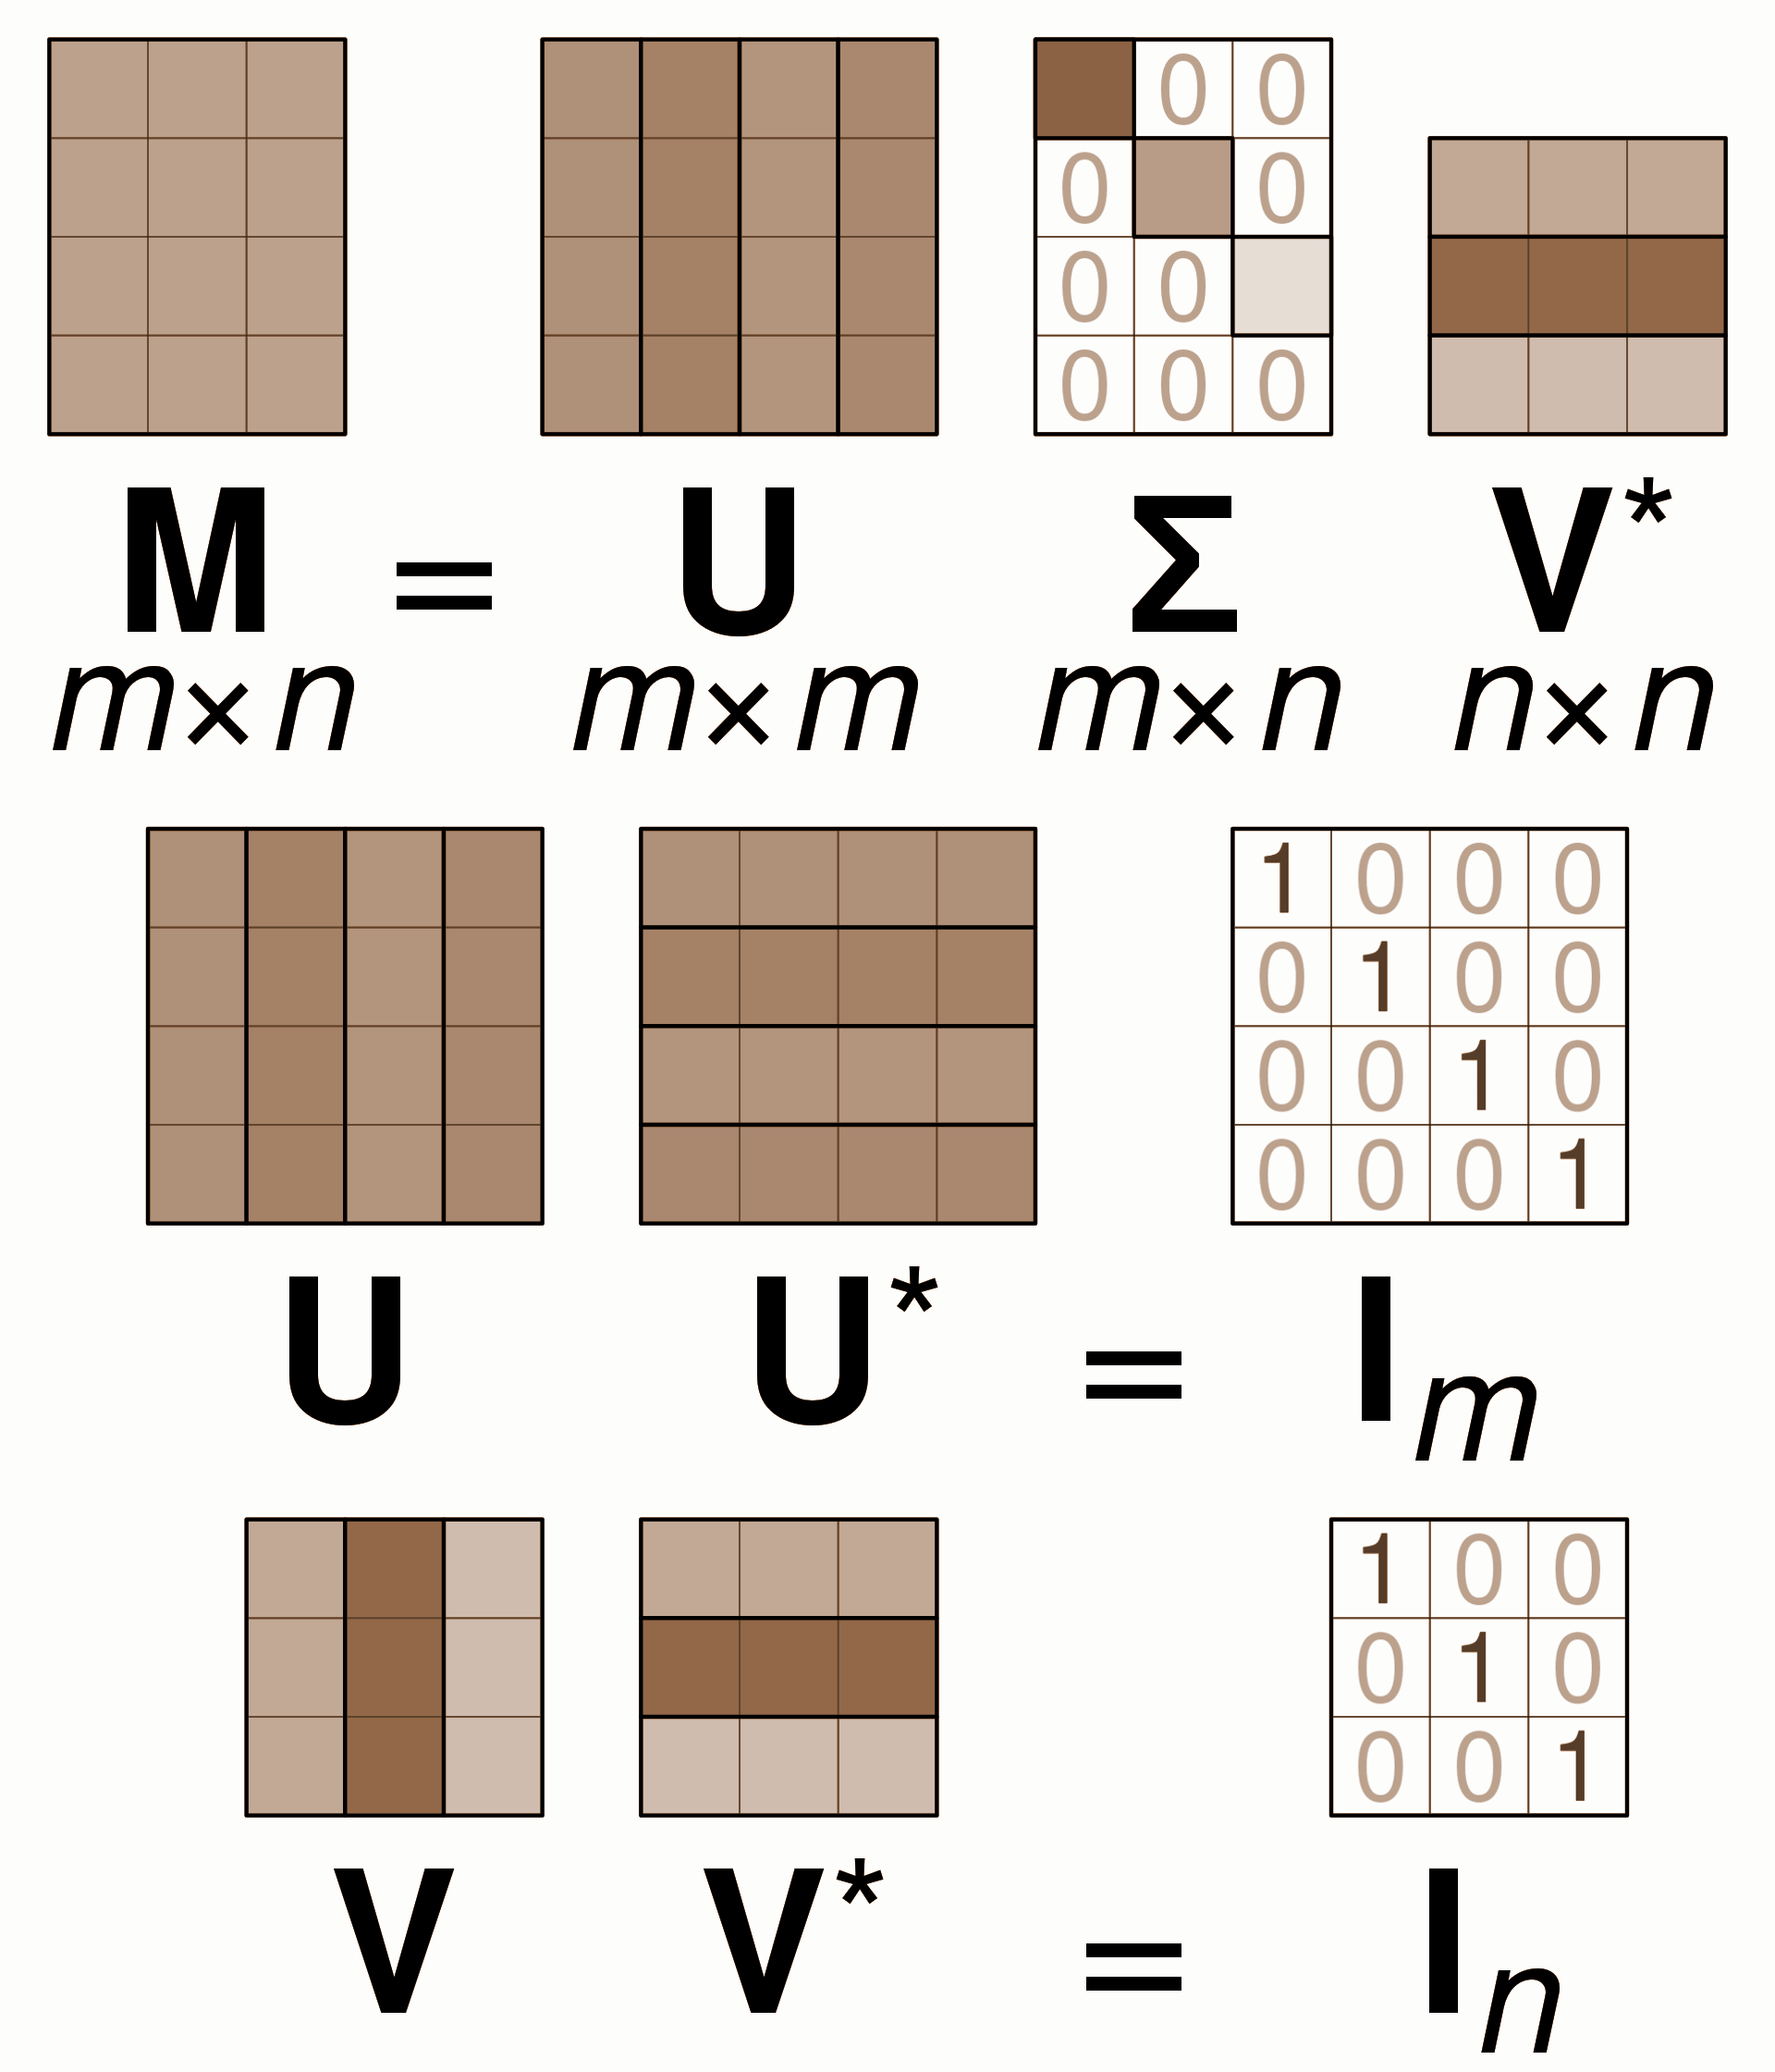
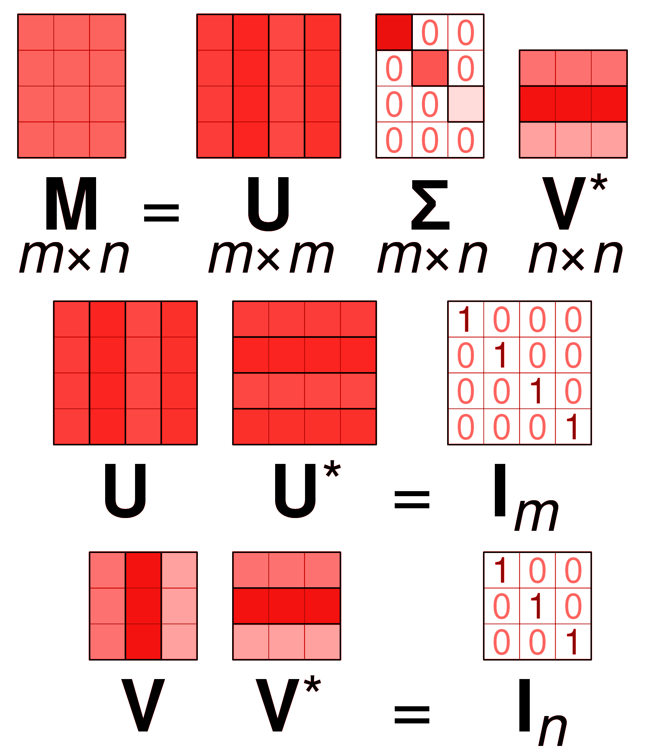

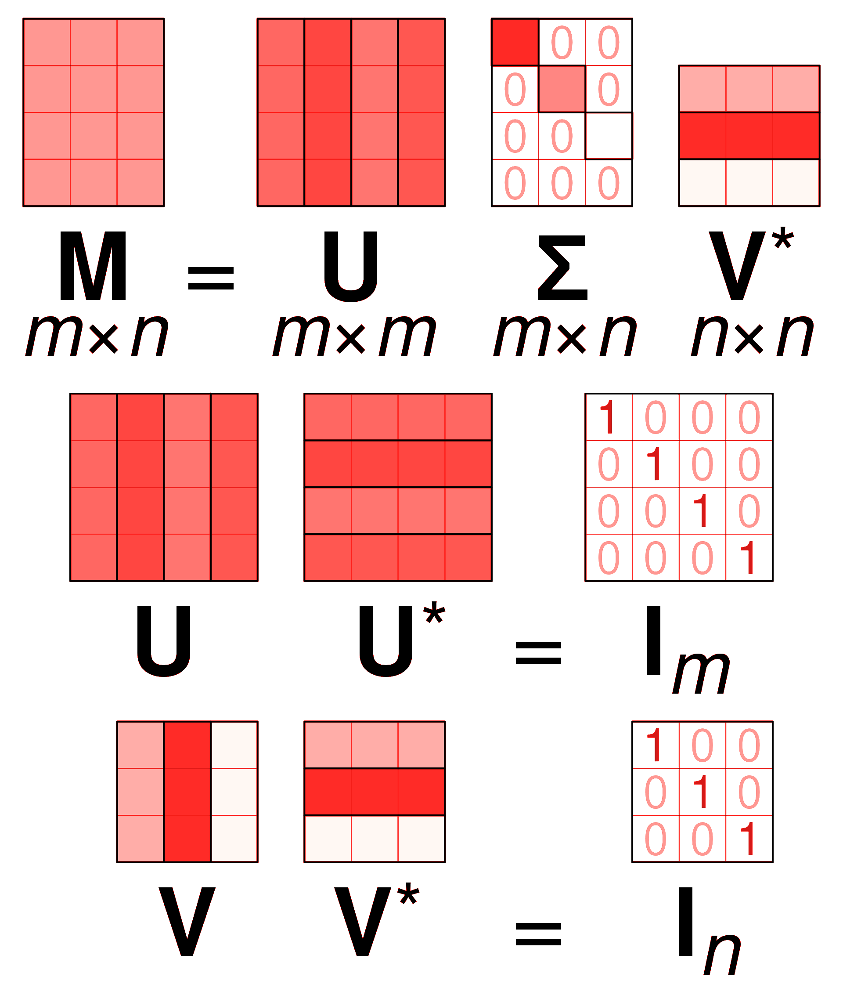
SVD to Pseudo-Inverse
Overdetermined Matrix X
Underdetermined Matrix X
X
U
S
X
=
U
S
V^{T}
=
V^{T}
mxn
mxm
mxn
nxn
mxn
mxm
mxn
nxn
X^{T}X = (USV^{T})^{T}(USV^{T}) = VS²V^{T}
XX^{T} = (USV^{T})(USV^{T})^{T} = US²U^{T}
(X^{T}X)⁻¹ = VS⁻²V^{T}
(XX^{T})⁻¹ = US⁻²U^{T}
X⁺ = (X^{T}X)⁻¹ X^{T} = VS⁻²V^{T}(VS^{T}U^{T})= VS⁺U^{T}
X⁺ = X^{T}(XX^{T})⁻¹ = (VS^{T}U^{T})US⁻²U^{T}= VS⁺U^{T}
X
=
V^{T}
S⁺
U^{T}
X⁺
=
V
S⁺
U^{T}
X⁺X = VV^{T} = I so (X^{T}X)⁻¹ X^{T} is left inverse of X.
X (X^{T}X)⁻¹ X^{T} gives projection onto Range(X)
XX⁺ = UU^{T} = I so X^{T}(XX^{T})⁻¹ is right inverse of X.
I - X^{T} (XX^{T})⁻¹X gives projection onto Null(X)

Slide 8
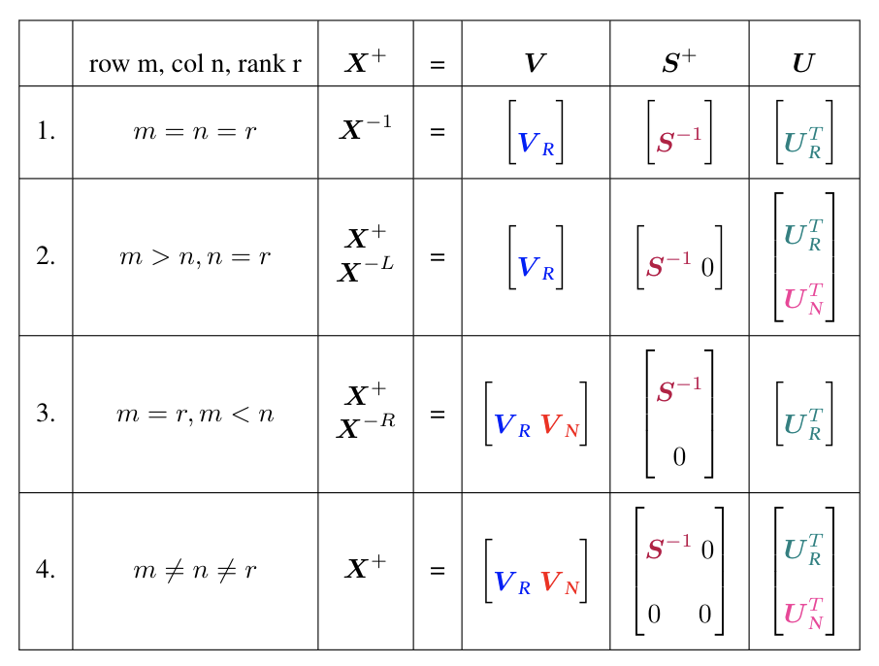
4 Scenerio: Block Form of Pseudoinverse

Slide 9
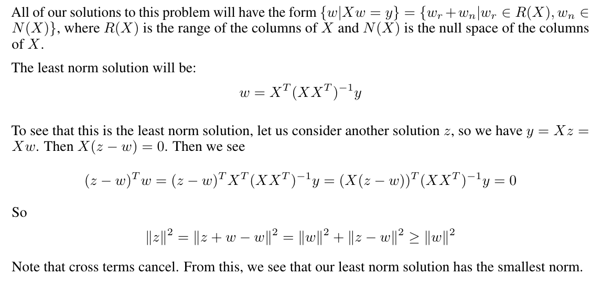
Moore Penrose Inverse Gives Us Minimum Norm for Underdetermined Systems

Slide 10
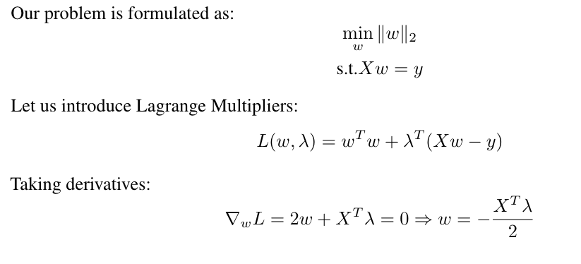
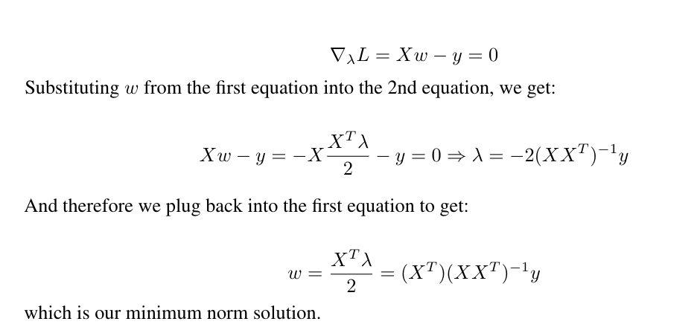
Lagrange Multipliers

Slide 11
Lagrange Multipliers

Slide 12
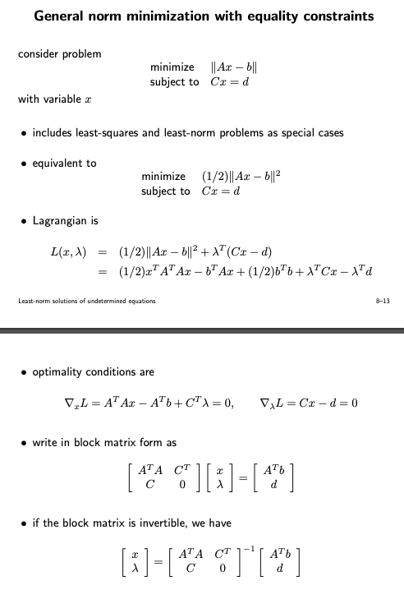
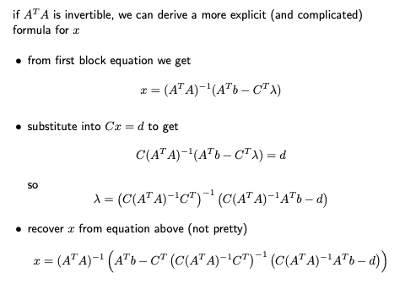
General Norm Minimization

Slide 13
Introduction to Brain Machine Interface

Slide 14
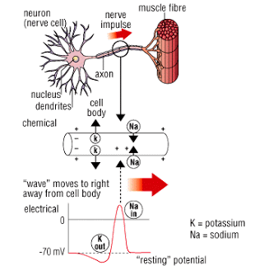
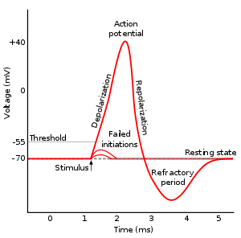
Basics of Electrophysiology
Neurons conduct via action potentials
Electrical pulses due to electrochemical gradient across membrane
Causes neurotransmitter release
With enough neurotransmitter, subsequent neurons activate action potentials and pass on the signal

Slide 15
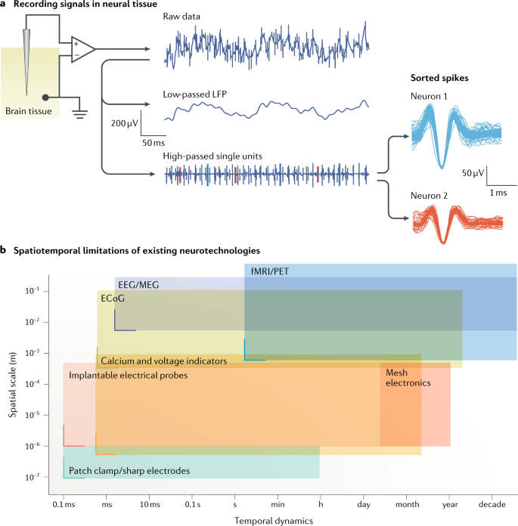
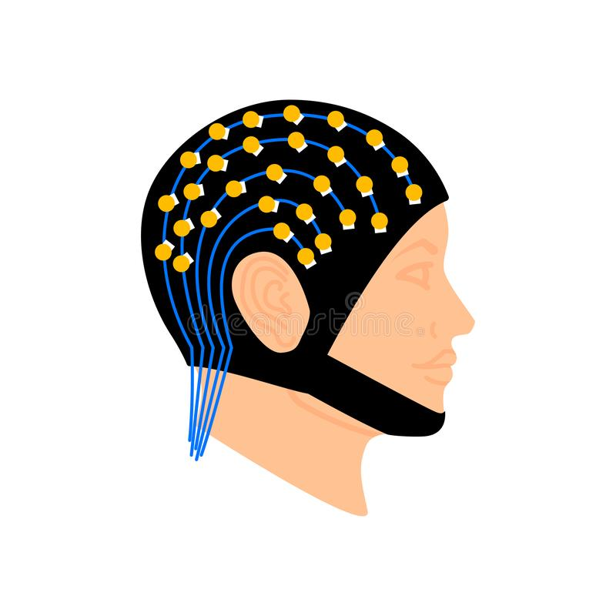
How signals are recorded: low level to high level
https://www.nature.com/articles/s41583-019-0140-6

Slide 16
EEG: time, frequency, space, phase
Event related potentials - with stimuli
Frequency domain analysis

Slide 17
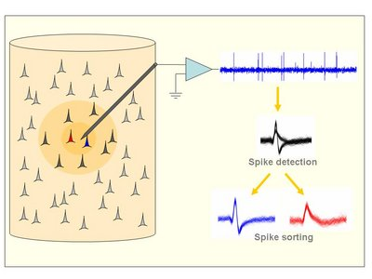
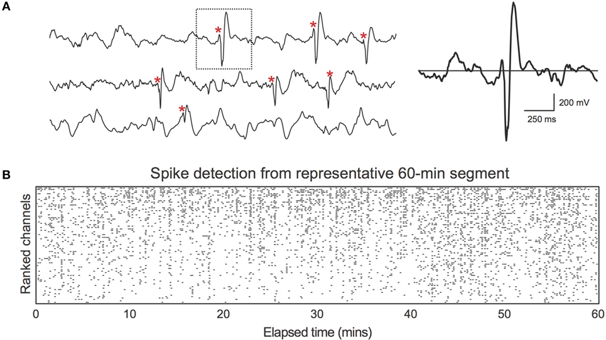
Extract Spike Waveforms from neural recordings
Filtering steps
Spike detection step
Waveform extraction and alignment
Notes:
http://www.scholarpedia.org/article/Spike_sorting

Slide 18
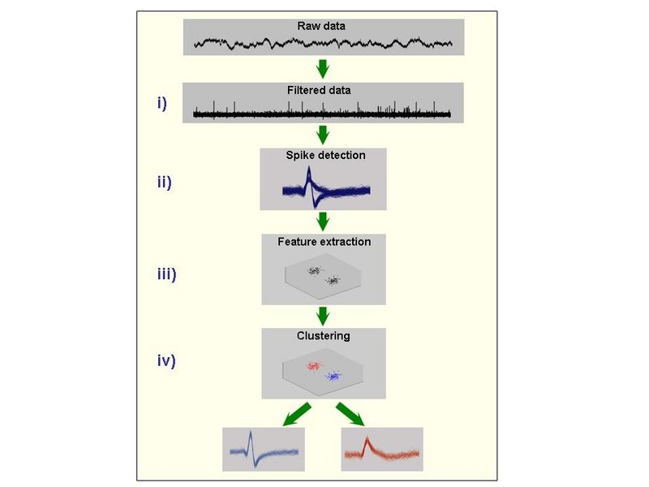
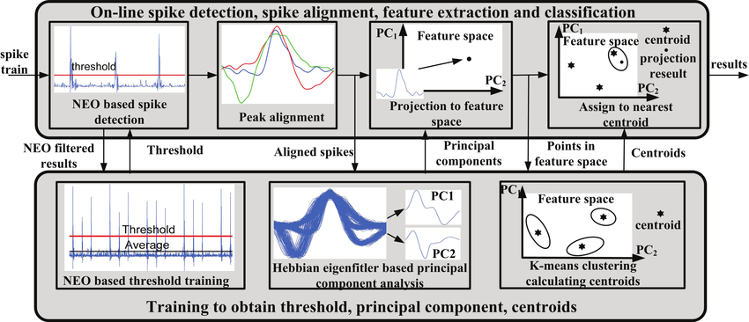
Application of PCA
Classify spike waveforms

Slide 19
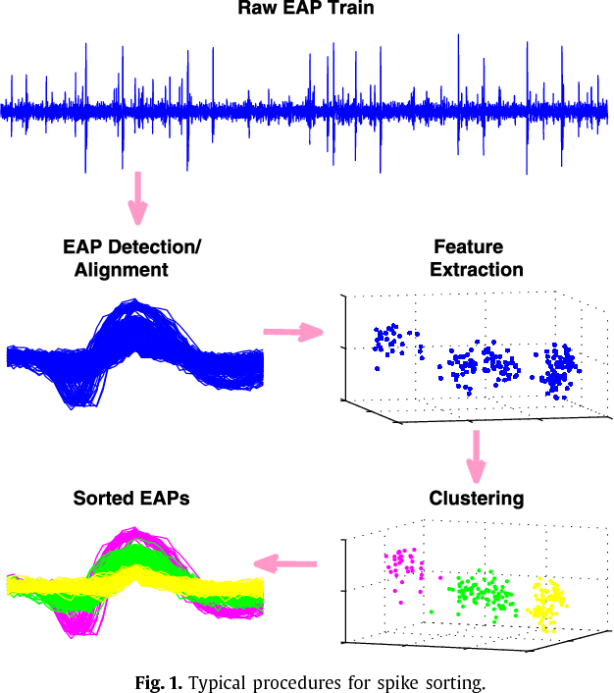
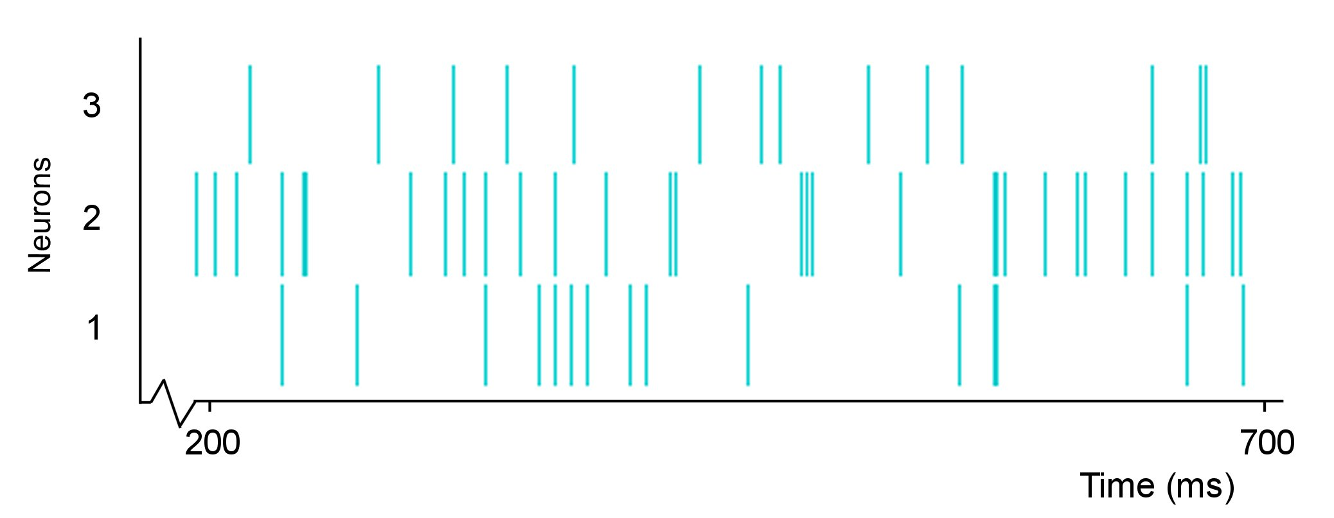
Spike Waveform clustering

Slide 20
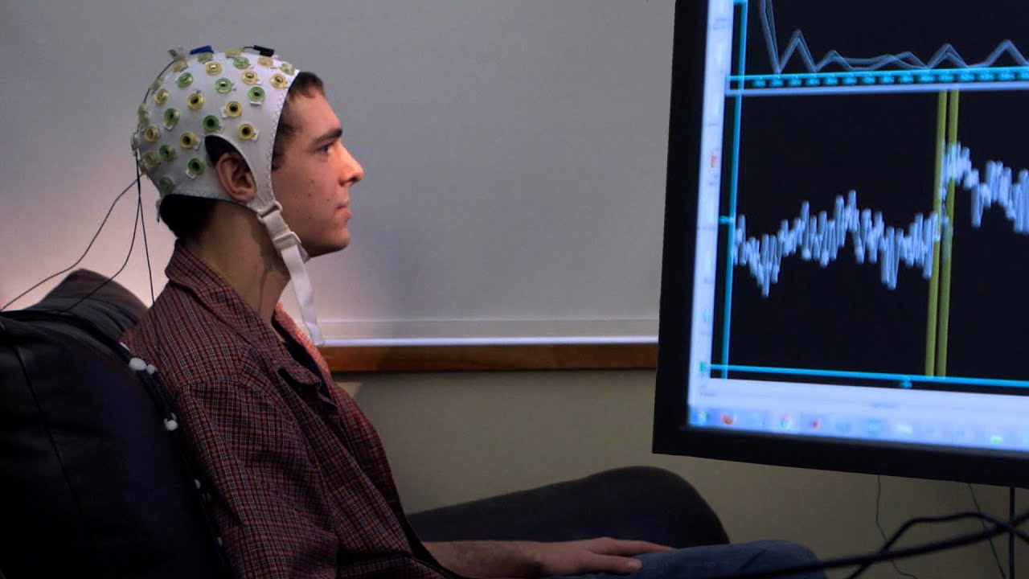
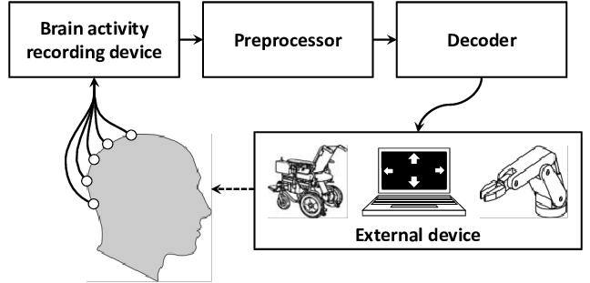
Brain Computer Interface
Decode from neurons (spike class) and spike train (frequency)

Slide 21
Why spike sorting important?
Important way to analyze electrophysiological signals from the brain
Your electrode is recording multiple neurons, and you want to understand what the neurons are firing in response to
So important to cluster and distinguish which spike is from which neuron
With accurate labelling -> can study connectivity patterns, neuronal responses to stimuli, neuronal activations to complete tasks, etc
https://www.sciencedirect.com/science/article/pii/S0361923015000684
Notes:
It is already well established that complex brain processes are reflected by the activity of large neural populations and that the study of single-cells in isolation gives only a very limited view of the whole picture (Brown et al., 2004; Buzsaki, 2004). Therefore, progress in Neuroscience relies to a large extent on the ability to record simultaneously from large populations of cells. The implementation of optimal spike sorting algorithms is a critical step forwards in this direction, since it can allow the analysis of the activity of a few close-by neurons from each recording electrode. This opens a whole spectrum of new possibilities. For example, it is possible to study connectivity patterns of close-by neurons (Buzsaki, 2004; Harris, 2005), or to study the topographical organization of a given area and discriminate the responses of nearby units (Quian Quiroga et al., 2005; Quian Quiroga et al., 2007). It is also possible to have access to the activity of sparsely firing neurons, whose responses may be completely masked by other neurons with high firing rates, if not properly sorted. Separating sparsely firing neurons from a background of large multi-unit activity is not an easy job, but this type of neurons can show striking responses (Hahnloser et al., 2002; Perez-Orive et al., 2002; Quian Quiroga et al., 2005).

Slide 22
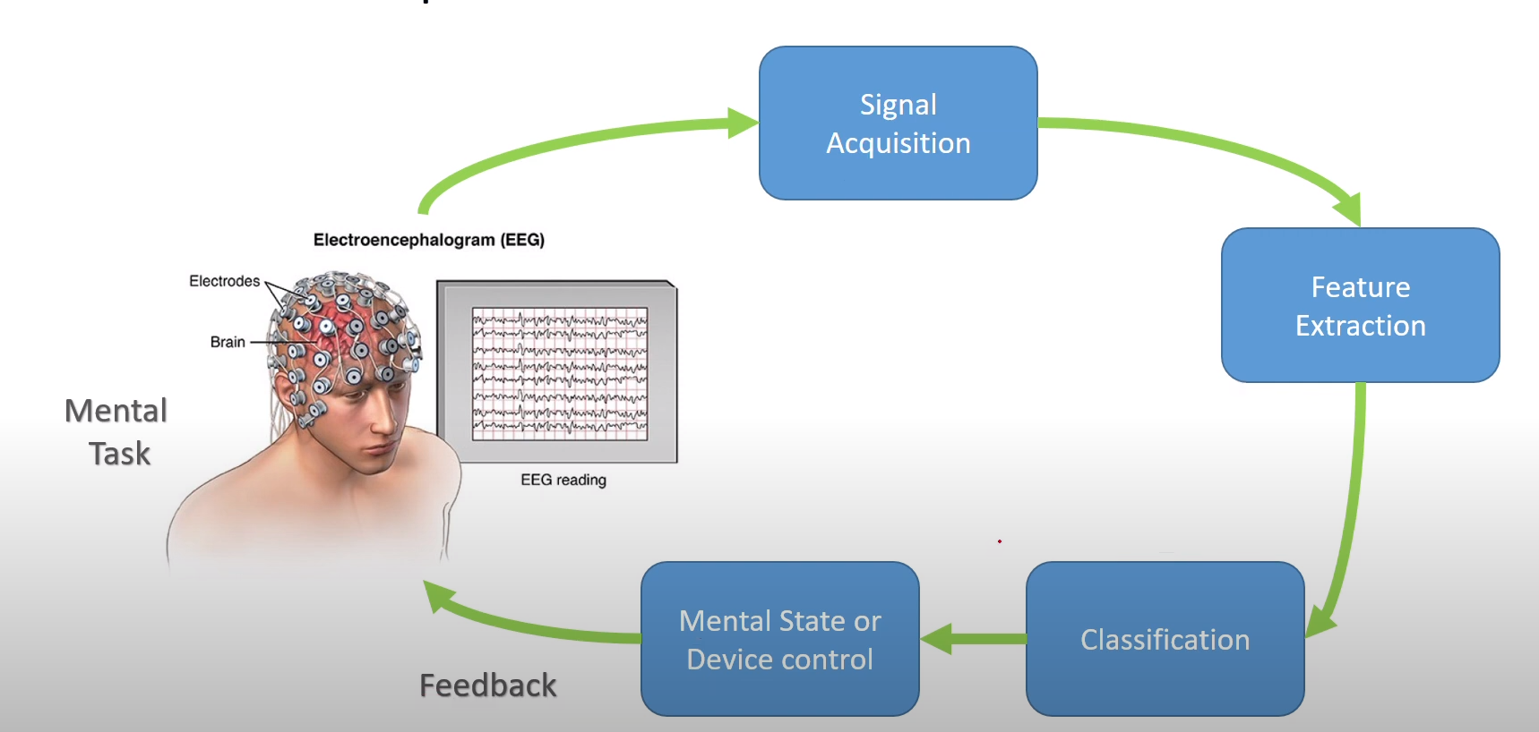

Slide 23
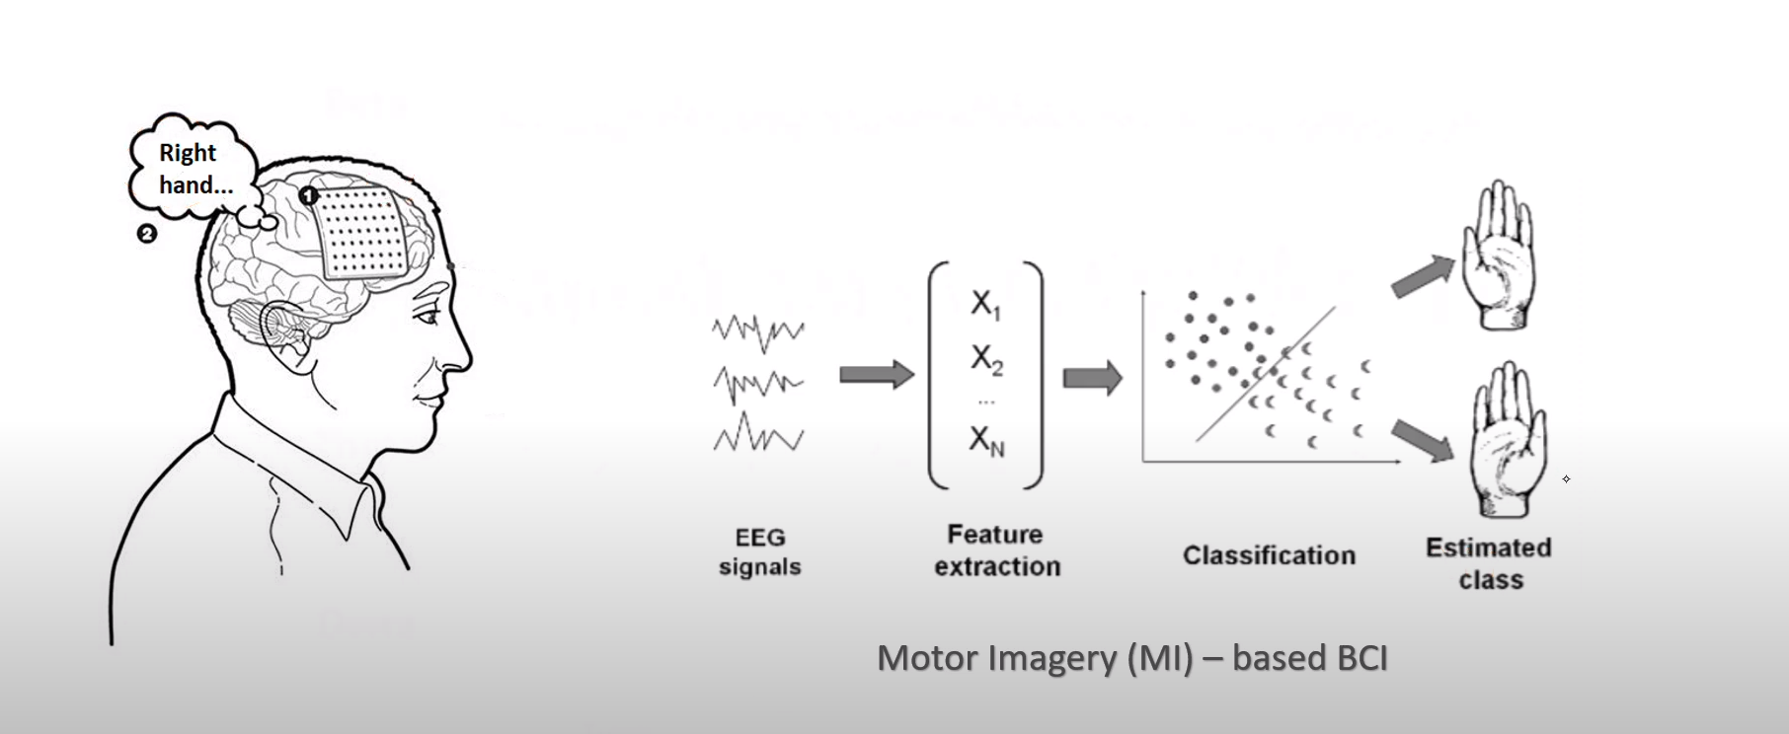

Slide 24
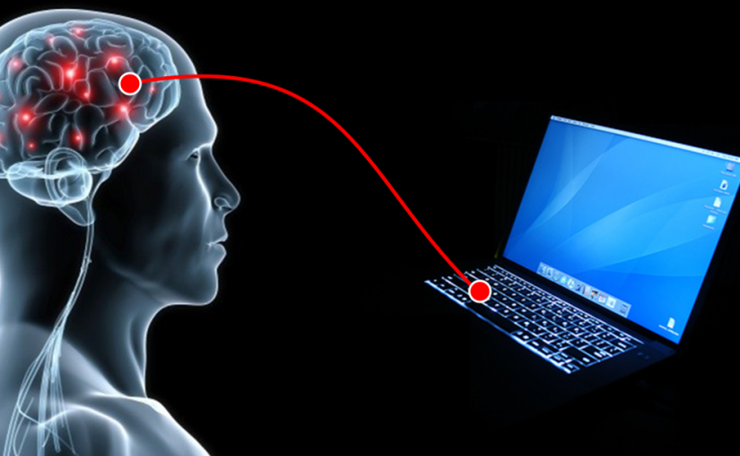
Do studd with the brain

